Slide 1

Houston, we have a problem: Big Data!
Notes:
High-dimensional data have become more common in many scientific fields as new automated data collection techniques have been developed.
It's estimated that 1.7 megabytes of data are created every second for every person on earth---the same amount of data needed to store an 850 page book, per second.
Our ability to generate, gather, and store volumes of data has far outpaced our ability to derive useful information from it in many fields, with available computational resources.
Such datasets pose a challenge for data analysis as standard methods of analysis, such as linear regression, are no longer appropriate. Therefore, data reduction is a critical step in order to turn large datasets into useful information, the overarching purpose of data science.
(https://time.com/6108001/data-protection-richard-stengel/)

Slide 2
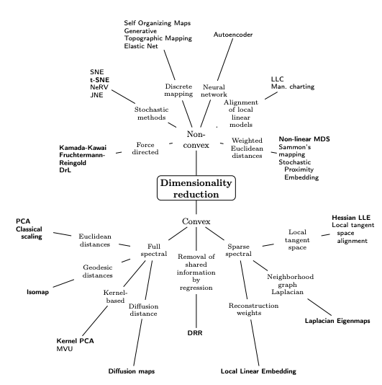
Dimension(ality) Reduction R Series
Part II - Feature Extraction; SP24
Instructor: Aishat Sadiq
Helper: Jacob Grippen
Notes:
In simple terms, to reduce an initial d-dimensional feature space to a k-dimensional feature subspace (where k < d).

Slide 3
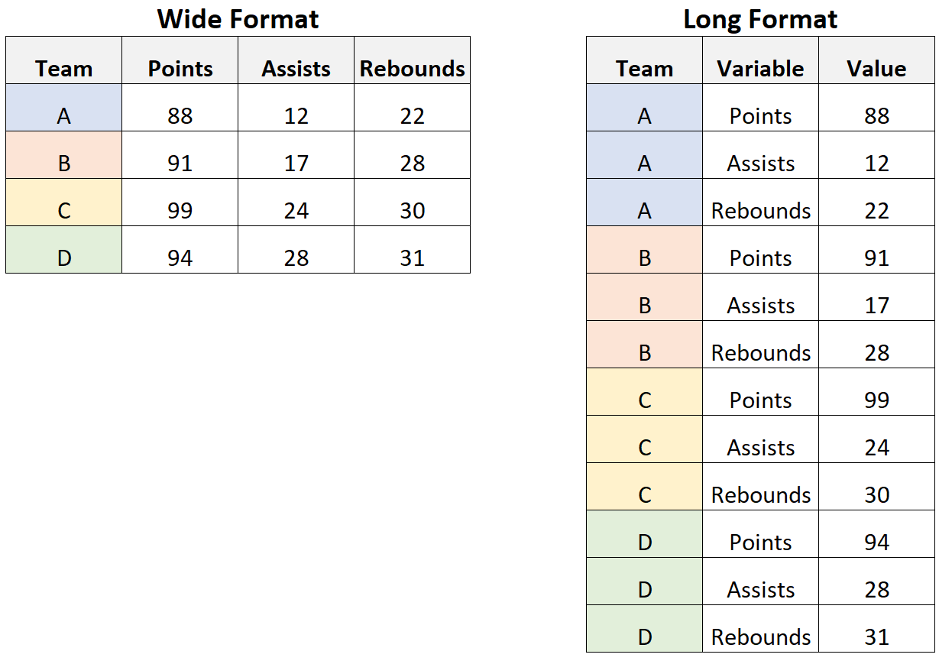
What are high-dimensional data?
Data in which the number of features (variables observed), p, are close to or larger than the number of observations (or data points), n.
Popular uses of high dimensional data:
Genomic data
Neuroimaging data
High-dimensional time series
Ecology (especially biodiversity studies)
Exploratory Data Analysis
Structural Equation Modeling
Topic modeling
Signal detection
Notes:
Similar to wide data learned in the Data Preprocessing Workshop.
I recently had to change very wide data to long data in order to run certain dissimilarity/segregation analyses using R and QGIS.
These all use models or algorithms to solve problems (like regression). But, high dimensional data can lead to long training times and model overfitting or even prediction and classification errors.
https://carpentries-incubator.github.io/high-dimensional-stats-r/aio/index.html

Slide 4
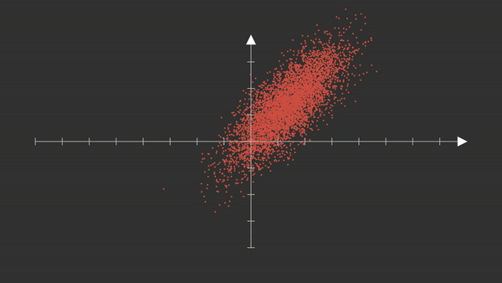
Agenda
Standardize data
Compute covariance matrix
covariance matrix measures relationships between differing features in the data
Matrix Decomposition
Eigenvalue decomposition helps in finding eigenvectors and eigenvalues from the covariance matrix. SVD directly decomposes the data matrix into singular vectors and singular values.
Component Selection
Order eigenvectors by decreasing eigenvalues (or singular values). Select the number of necessary eigenvectors based on the desired number of principal components or the amount of variance to be retained

Slide 5
Research Study
"We study race in the labor market by sending fictitious resumes to help-wanted ads in Boston and Chicago newspapers. To manipulate perceived race, resumes are randomly assigned African-American- or White-sounding names. White names receive 50 percent more callbacks for interviews. Callbacks are also more responsive to resume quality for White names than for African-American ones. The racial gap is uniform across occupation, industry, and employer size. We also find little evidence that employers are inferring social class from the names. Differential treatment by race still appears to be prominent in the U. S. labor market.” (Bertrand & Mullainathan, 2004)
Notes:
- Measured whether a given resume elicits a call back or e-mail back for an interview. For each phone or email response, we use the content of the message left by the employer (name of the applicant, company name, telephone number for contact) to match the response to the corresponding resume-ad pair.
Not a workshop to analyze the merits of the study, but to use the data to understand big data methodology!! Its one of the largest clean datasets I could find.
- Limitations: crude approximation for outcome measure (call back), and use of names to indicate race
https://vincentarelbundock.github.io/Rdatasets/doc/openintro/labor_market_discrimination.html
https://www.nber.org/system/files/working_papers/w9873/w9873.pdf

Slide 6
Github
Download all the Github files
Unzip package
Open project and script files using R project file
Readme section of the Github page

Slide 7
Live Coding: Prep Steps
Open RStudio
Install packages
Import dataset
labor_market_discriminiation
dim(), describe()
Notes:
Important to learn your dataset, happens during pre-processing steps.
chrome-extension://efaidnbmnnnibpcajpcglclefindmkaj/https://www.nber.org/system/files/working_papers/w9873/w9873.pdf

Slide 8
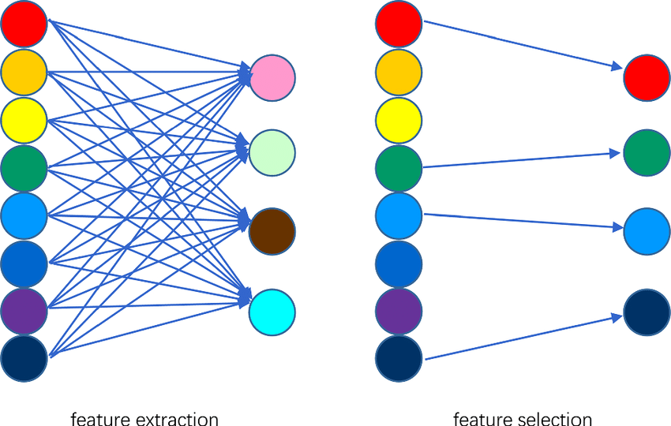
Feature Extraction vs. Feature Selection
Uses domain knowledge and/or statistical tests to select the most relevant variables.
Constructs a new set of dimensions
Notes:
Feature selection is about choosing the most important features from your dataset to use in your analysis. You're selecting specific features that are most relevant to your problem.
Feature extraction is about creating new, more meaningful features from the existing ones. You're transforming or combining the original features to capture the most important information in a more compact way.

Slide 9
Definition
Linear Feature Extraction aims to reduce the dimensionality of the dataset by creating new linear combinations of the original features while retaining as much relevant information as possible

Slide 11
Popular Feature Linear Extraction Techniques
Principal Component Analysis (PCA)
Independent Component Analysis (ICA)
Factor Analysis (FA)*
Linear Discriminant Analysis (LDA)
Singular Value Decomposition (SVD)
Non-negative matrix factorization (NMF)
Notes:
PCA looks for dimensions with greatest variance between components then transforms the coordinates of each data point to fit the new dimensions. This should minimize the distance between similar data points and maintain distances between dissimilar data along the new component axis to preserve the original space structure as much as possible. Unsupervised learning!

Slide 12
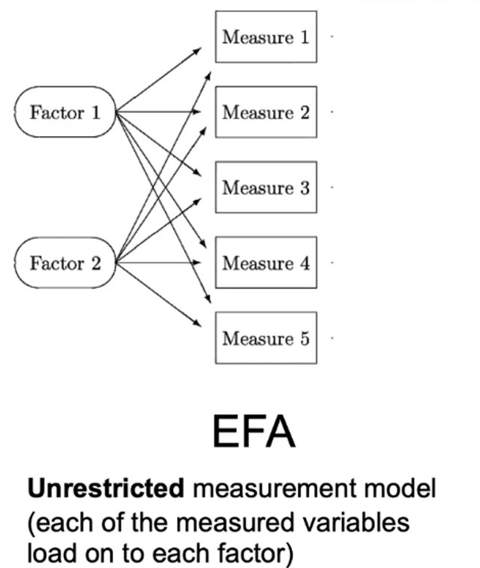
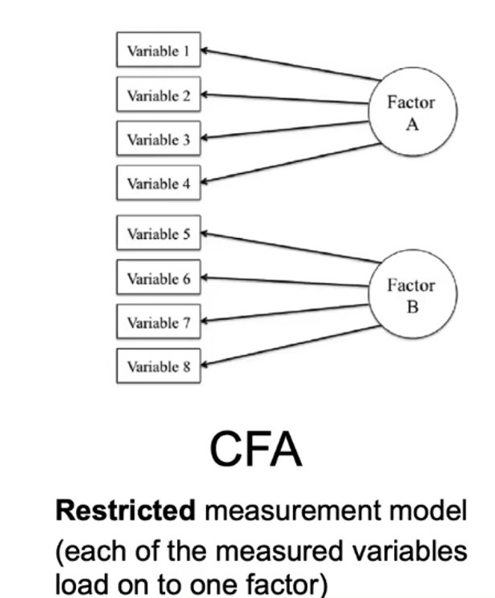
Types of Factor Analysis
EFA
CFA + SEM
Notes:
Slide 6 - Types of FA: CFA & EFA
Two types of factor analysis: Exploratory and Confirmatory
Exploratory Factor Analysis - Used to explore underlying structure of a dataset when a researcher does not have any specific a priori hypotheses about the number or structure of the latent variables.
Objective is to determine the number of factors influencing a set of measured variables and assess the strength of the relationship between each factor and each observed variable.
Each observed variable is a linear function of the unobserved factors.
Confirmatory Factor Analysis - Used when a researcher has specific hypotheses about the number of factors and which observed variables are related to which factors. Primary objective of a CFA is to determine the ability of a predefined, hypothesized model is consistent with data

Slide 13
Non-linear Techniques/Manifold Learning
[Student] t-distributed Stochastic Neighbor Embedding (t-SNE)
Kernel PCA
Iso-map, UMAP
Multidimensional Scaling (MDS)
Autoencoders & Neural Networks
Locally-linear embedding (LLE)
Notes:
Lasso & Ridge Regularization?
The R package Rtsne implements t-SNE in R.

Slide 14
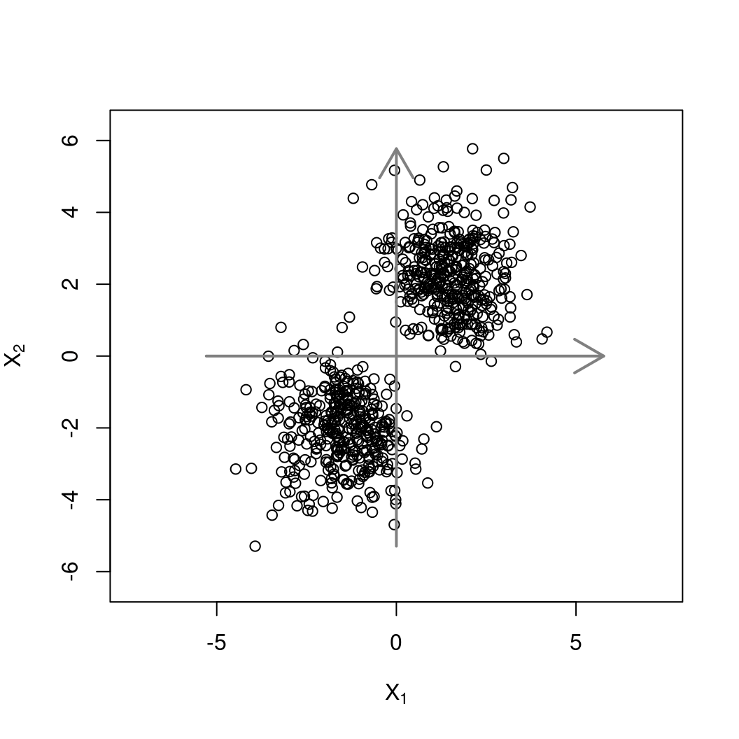
PCA is the most popular DR method
When the dimensionality p is large, PCA is commonly used in exploratory data analysis and for extracting features and developing models.
The key concept here is principal component (PC) of variability.
The first principal component is the direction that maximizes the variance of a projection of the data onto a single line in feature space.
The second principal component can be taken as a direction orthogonal to the first principal component that maximizes the variance of the remaining components of the projected data
Notes:
https://discdown.org/dataanalytics/principal-component-analysis.html
PCA reduces dimensionality by projecting each data point onto only the first few principal components to obtain lower dimensional data representations, while preserving as much of the data’s variation as possible. Overall, PCA amounts to a change of basis of the coordinate axes in feature space in order to capture the most variability of the data along the new axes. Thus, PCA extracts features that retain the most amount of the variance/covariance in the high dimension data. Since these projections are linear operators, they can be easily implemented using a singular value decomposition (SVD) of its variance–covariance matrix with optimized and very fast linear algebra software libraries.

Slide 15

Workshop Evaluation QR Code
Notes:
https://forms.office.com/Pages/ResponsePage.aspx?id=ZkN-XZsbz0WOebFLJ99G4SUXqdLlghJDhzZ5bd0gLPtUQVlLU0pBRlVLN1dGUkVTQUE2VFE0UThKQi4u&origin=QRCode

Slide 16
Be careful of P-hacking!!
Notes:
These methods can lead to inflated performance metrics and false discoveries in social science research especially because of the focus on correlation!!
Machine learning often involves testing many hypotheses simultaneously, especially when exploring different models, feature sets, or hyperparameter combinations. Without appropriate corrections for multiple comparisons, researchers may report statistically significant results that are actually false positives.

Slide 17
What questions do you have?

Slide 18
Resources
Garson, G.D. (2022). Factor Analysis and Dimension Reduction in R: A Social Scientist's Toolkit (1st ed.). Routledge. https://doi.org/10.4324/9781003279693

Slide 19
Workshop Evaluation QR Code
Notes:
https://forms.office.com/Pages/ResponsePage.aspx?id=ZkN-XZsbz0WOebFLJ99G4SUXqdLlghJDhzZ5bd0gLPtUQVlLU0pBRlVLN1dGUkVTQUE2VFE0UThKQi4u&origin=QRCode

Slide 20
Definition
Feature Selection is the process that removes irrelevant and redundant features from the data set. The model, in turn, will be of reduced complexity, thus, easier to interpret.

Slide 21
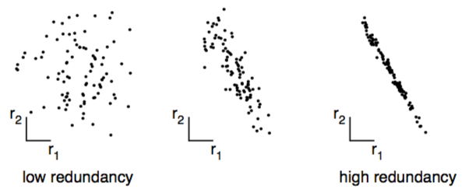
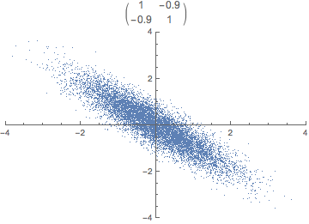
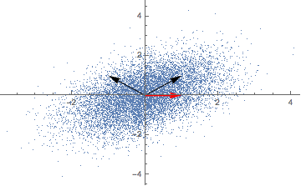
Notes:
The goals of PCA are: (1) minimize redundancy in our data set, and (2) preserve maximal variance within the data.
PCA comes with assumptions:
Linearity & Orthogonality - we use covariance, a linear relationship, as a measure of redundancy and are restricted to express the data set in an orthogonal basis¹
Greater Variance Means Greater Information, directions with greater variance are assumed to represent a more interesting structure
Recap that one of our goals was to minimize redundancy in our transformed data set. With the notion of covariance, we can state that goal more formally: all off-diagonal items of covmat(Y) should be zero. In other words: we decorrelate the data.
https://fastpaced.com/articles/principal-component-analysis/

Slide 22
